Slide 1

Concept Pitch
Team: Harrison Seitz, Malvika Singh, Nicole Yin, Tyler Wright
June 12, 2024

Slide 2
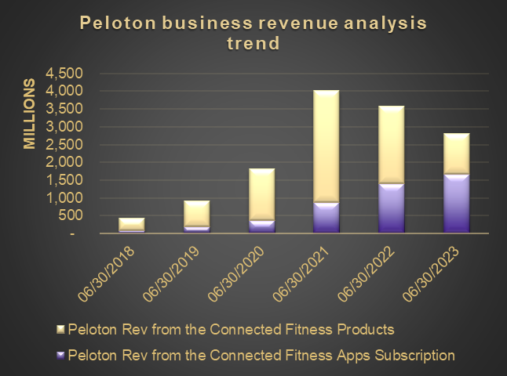
Business Context
Peloton Dilemma
Situation:
Although Peloton revenue gain tripled in 2020-2021 due to Covid-19, the revenue growth is slowing down recently.
Problem:
Fierce competition due to the new entry players and the low-end connected fitness product offerings
Consumer fitness behavior is dynamic after Covid-19 due to gyms reopening
High marketing costs to acquire new customers due to high upfront fitness equipment+subscription purchase (~$2000)
Therefore, to continue growing the business, Peloton needs a new product strategy to fill the unmet market needs in a post-Covid-19 environment.
Figure 1: Peloton business revenue analysis trend
Source: https://investor.onepeloton.com/financial-information/annual-reports
Notes:
before that, I'd like to open with the current peloton dilemma
as what you see in the chart, it is the 6 years of peloton revenue trend

Slide 3
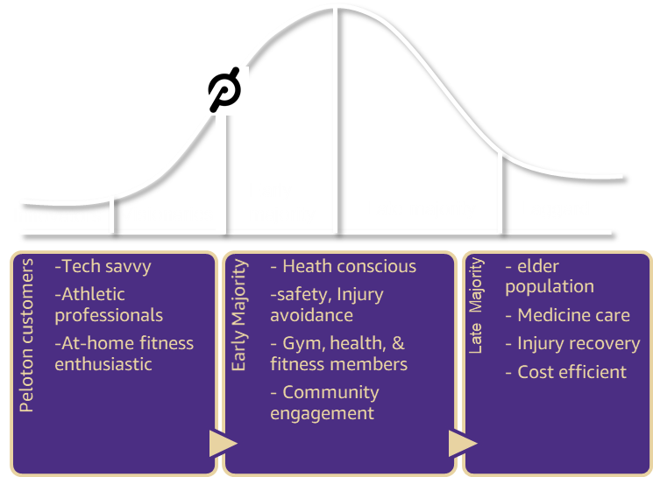
Peloton Technology Adoption Life Cycle
Next strategy to move to the mass market where the group of early majority sit in
Covid-19 accelerated Peloton customers growth of individuals who exercise at-home due to gym/club closing.
In the post-Covid-19 environment, Peloton product strategy will turn to target the “Early Majority” section of the connected fitness market.
Figure 2: Peloton technology adoption life cycle
Notes:
To understand where peloton should go, we have to understand where we are.
In the past few years, peloton product focus on those innovators and visionaries who are tech savvy, passionate about the at-home fitness, has professional knowledge in the fitness training. This population was growing fast during the cov-19 due to gym/club closing.
It pushed peloton achieve the level to acrossing the chasm,
in the next cycle, Peloton have to figure out the strategy to target the “early majority: section of the connecte fitness.

Slide 4
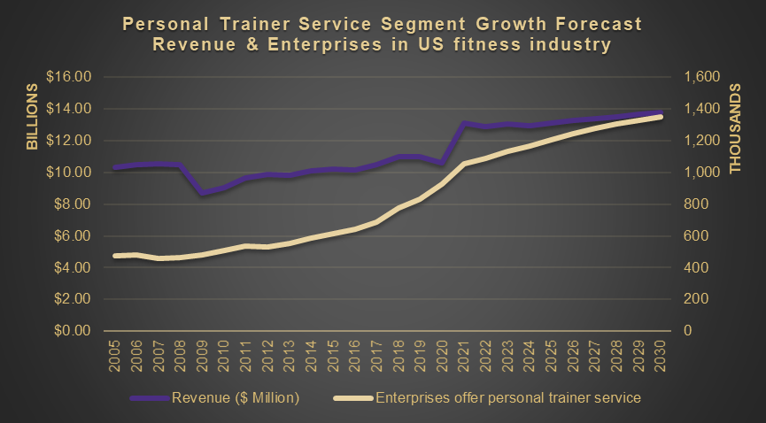
Market Opportunity
$12 billion market value and 1.2 million business market size!
High growth of personal trainer services due to health consciousness grips the public
In-home personal trainer service demand is up , due to gym/club reopening and return-to-office policy post Cov-19.
High margin profit service segmentation
Low innovation and fragmented product technology support
Figure 3: Personal Trainer Service Segment Forecast
Source:https://my-ibisworld-com.offcampus.lib.washington.edu/us/en/industry-specialized/od4189/external-impacts-questions
Notes:
So where are they? In the previous slide, we talked about they mostly have members of at least 1-2 fitness/gym/club. By looking into the industry, we found unlike the gym membership which is declining, the personal training service segment is growing really fast.
This slide is to indicate the importance of personal trainers to end users so that we can leverage the opportunity that if we can build better communication systems between the two groups, the small gym businesses, independent gym trainers would boom and the end user will also be satisfied. We can remove this if it is not making sense after discussion

Slide 5
Target Customer
B2B connected fitness market
Small gym owners or franchisees whose customers have a wide range of personalized fitness needs and a desire for high quality and engaging workout experience.
Examples of small gym owners who provide personal training services include freelance trainers, part time gym owners, gym instructors who interact and engage with individual clients remotely and in-person.
Notes:
Based on our study, we decide to move in B2B connected fitness market segment, start from xxx

Slide 6
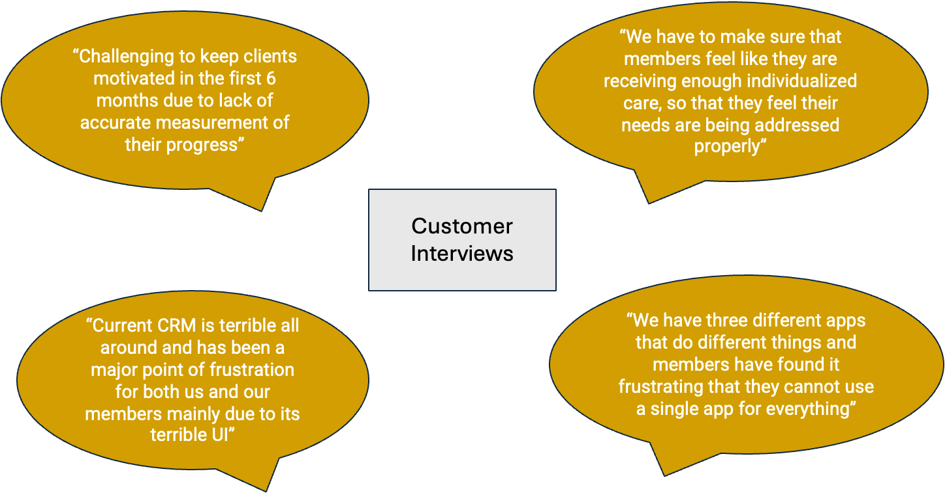
Customer Voice
Notes:
In the past 2 months, to understand our selected target customer painpoint, we conducted 5 interviews covered personal trainer, small business gym owner, health wellness stakeholders, and CMO of fitness company. to listen what they have said.

Slide 7
Problem to be Solved
〝As the owner of a fitness franchise, I struggle to meet personalized clients' needs, leading to low engagement and high membership attrition. Addressing this challenge is crucial to enhance service quality and foster lasting trust with customers.〞
Notes:
Eventually, we are able to defined their problem is “xx

Slide 8
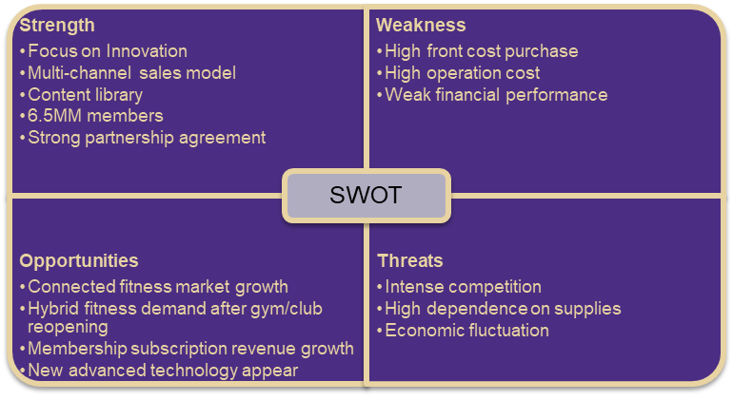
Our Solution - “Peloton Breakaway”
A top notchy connected fitness platform strategy
Our Assumption
As the dominant player in the connected fitness industry, Peloton seeks to sell the highest quality product in the fitness world and create an experience for their customers that is second to none.
Peloton Breakaway
is a digital solution to create a new pricing model, platform-based app strategy to help small gym owners or franchisees to connect their members with an immersive, engaging workout way.
Notes:
To solve the problem, please allow me to introduce our peloton solution - Peloton breakaway, a new connected fitness platform strategy

Slide 9
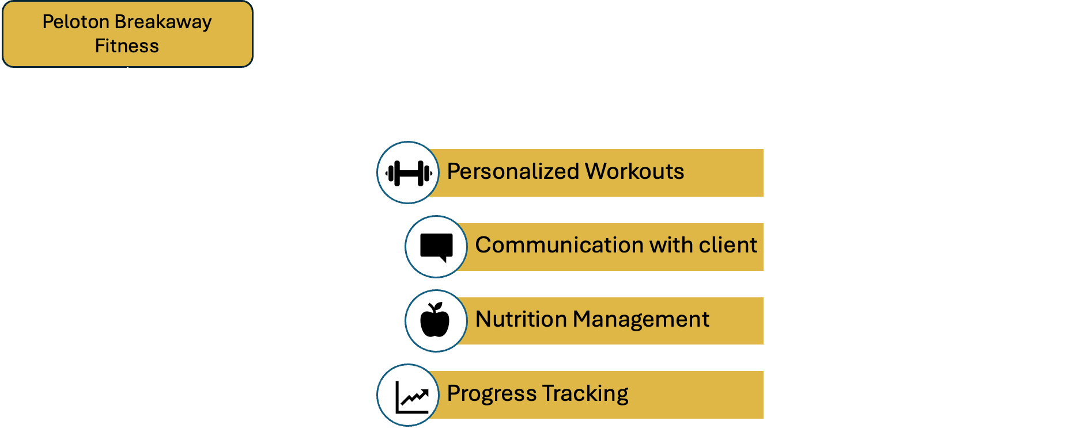
High Level Solution to Problem

Slide 10
Value Proposition & Competitive Positioning
For small gym business owners and trainers with clients,
Who need an integrated system to provide personalized fitness and wellness programming to their clients, Peloton Breakaway is a solution that helps gym businesses and trainers provide tailored workout regimens and nutritional advice based on individual performance and fitness monitoring data. This enhances both gym and remote exercise sessions for clients, providing a seamless fitness experience.
Unlike competitors in the connected fitness sector, Peloton Breakaway is a one-stop solution for effectively engaging with clients to give them holistic, engaging and 1:1 fitness experience. By offering versatile fitness solutions, Peloton Breakaway fosters higher satisfaction and retention rates.
Notes:
We can leverage the Peloton Brand as another point of differentiation, market leader in connected fitness, with a large number of potential partnerships

Slide 11
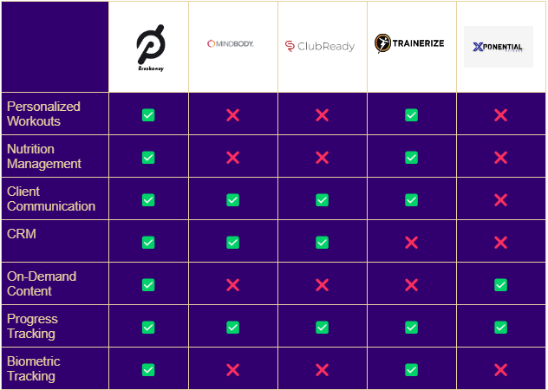
Competitor Analysis

Slide 12
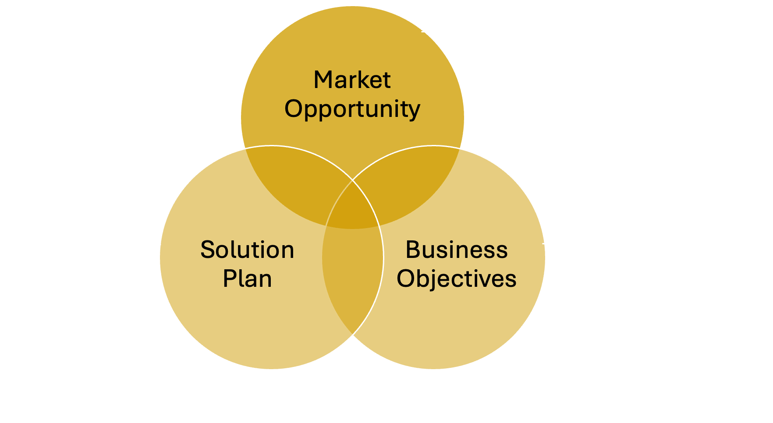
Product-Market Fit

Slide 13
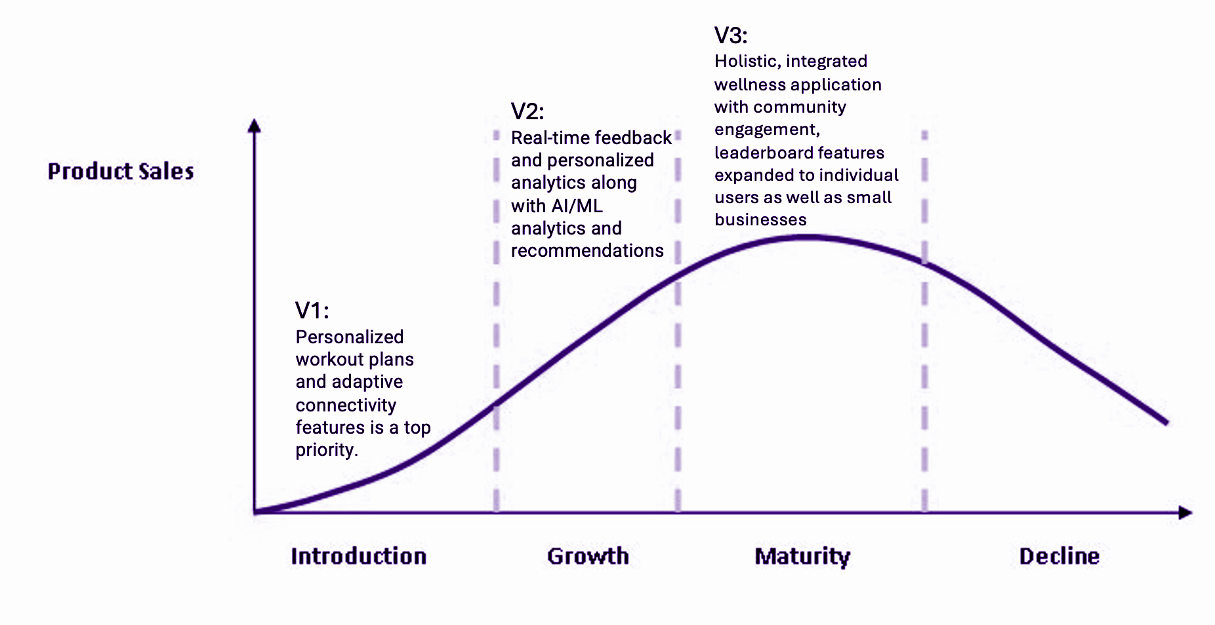
Release Themes
Figure 4: Product Lifecycle
Source: https://images.app.goo.gl/uWsWCukasHgoujGo9

Slide 14
Release Theme Drivers: Vision Molecule
Strategy Element | Objective (SMART) | Features (What will we do?)
Host platform for personalized workouts | Increase volume of monthly trainer session booking by 20% in first 6 months of V1 | Trainers can select and provide workouts from there to their clients. Integrate video sharing for live training sessions.
Provide clients with on-demand nutrition guidance | Increase app adoption among new members of partnered businesses by 25% by end of year | Trainer can build personalized nutrition plan and share. Calendar integration for daily meal planning.
Monitor performance remotely | Increase adoption of fitness tracking among users by 50% within first six months of launch | Users can automatically upload their fitness data from smartphones and wearables.
Simple and easy to navigate UI | Increase adoption-rate of app among all age groups by 20%, and by 50% for elderly (65+) age group, within first year of launch | Make UI intuitive + easy to understand so that even the least tech-savvy user segments can interact with it easily.
Notes:
64 million total market . 40% are high-end users so 25 million, we are aiming to capture 5% of that mark
1.2 million is establishment providing personal training service, 30% is self-employee personal training which you start target, 40% of gym center (but here you only target <500 members small business, we can justice it), your most rev from.

Slide 15
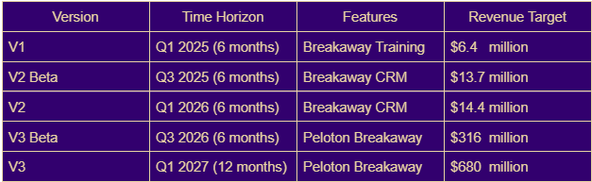
Business Value

Slide 16
The “Ask”
We seek approval of the esteemed company panel to give us a go ahead signal/feedback to develop the concept pitched in this presentation.

Slide 17

Thank you!

Slide 18
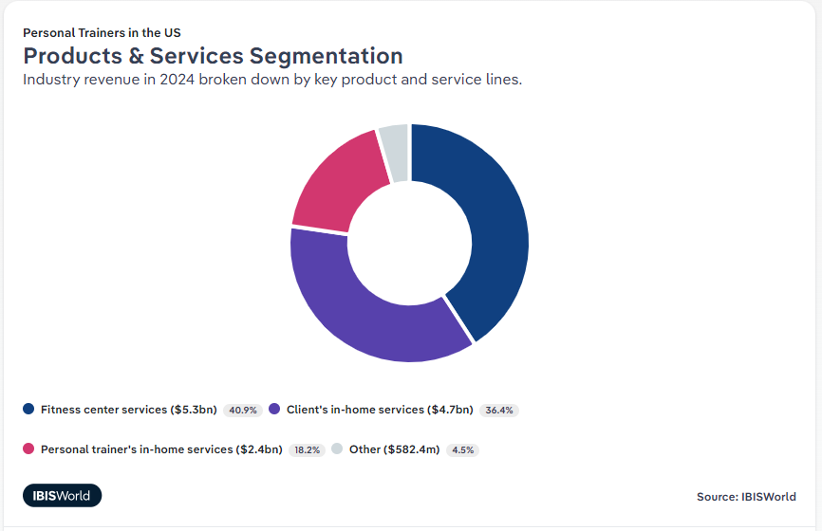
Personal trainer service segmentation

Slide 19
Customer Interviews
Arushi, 34, Small gym business owner
Malikka, 32, Small gym business owner and personal trainer
Casey, 38, Small gym business owner
Capt Andy, 36, Physiotherapist, Military
“We have to make sure that members feel like they are receiving enough individualized care, so that they feel their needs are being addressed properly”
“I have to adjust the training plan for the members who are on business trips and have hard time monitoring their progress”
“I want [students] to have the same sense of accomplishment, I want them to feel valued, I want them to have an authentic experience, I want them to have fun but also to feel connected"
“Work with nutrition department separately to co-ordinate their results and plans for the patients”
“Current CRM is terrible all around, it needs a lot of improvements and has been a major point of frustration for both us and our members mainly due to its terrible UI”
“It is challenging to keep her members motivated and encouraged to keep in the first 6 months due to lack of accurate measurement of their progress”
“I monitor and survey injury type for all patients manually”
Ease of communication is a key need
Reliability and ease of use are the most important factors
Engagement with members is what keeps them coming back
Being able to integrate multiple functions into a single app
Integrated platform to communicate, monitor fitness, suggest workouts for clients who are in a different location or if she is traveling but still has to train clients to keep continuity
Needs integrated nutrition planning
Good Remote training and monitoring experience for clients
Workout time needs to fit in between work, kids, and other commitments.
Needs integrated nutrition management system
Some way to measure and record fitness progress, recovery

Slide 20
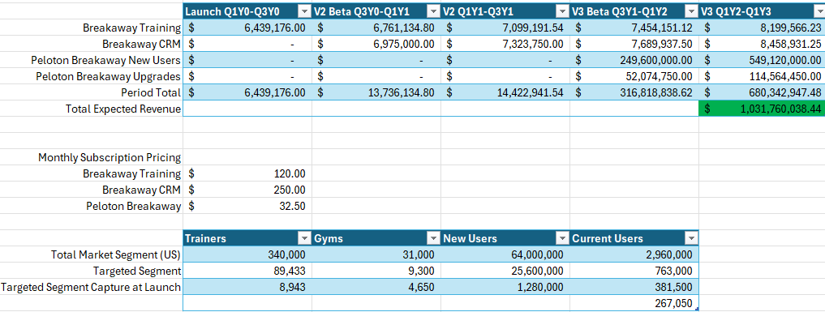
Revenue Forecast Model
Notes:
I think total gym size total is not 3100*3, i think gym size of us is more than that.

Slide 21
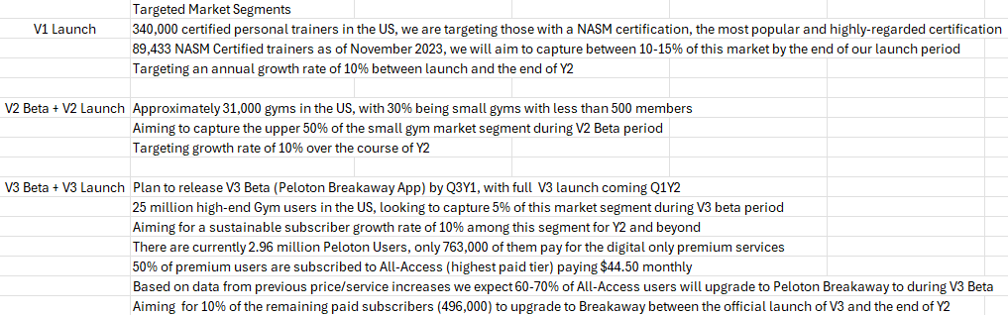
Revenue Forecast Assumptions
Notes:
Can you screenshot table again?

Slide 22
References and Appendix Section
https://investor.onepeloton.com/financial-information/annual-reports
https://my-ibisworld-com.offcampus.lib.washington.edu/us/en/industry-specialized/od4189/external-impacts-questions
https://my-ibisworld-com.offcampus.lib.washington.edu/us/en/industry-specialized/od4189/products-and-markets
https://my-ibisworld-com.offcampus.lib.washington.edu/us/en/industry/71394/geographic-breakdown
https://my-ibisworld-com.offcampus.lib.washington.edu/us/en/industry/71394/competitive-forces
https://my-ibisworld-com.offcampus.lib.washington.edu/us/en/industry/33992b/competitive-forces
https://clients-mintel-com.offcampus.lib.washington.edu/report/exercise-trends-us-2023?fromSearch=%3Ffreetext%3DComputers%2520and%2520Peripherals%26resultPosition%3D2
https://www.mindbodyonline.com/business/pricing?utm_source=google&utm_medium=ppc&utm_campaign=20525731563&ad_group=&utm_term=&utm_device=c&referralSource=paid+search&matchtype=&cid=&networkType=&adgroupid=&creative=&network=x&adGroup=&_bk=&_bm=&gad_source=1&gclid=CjwKCAjwjqWzBhAqEiwAQmtgT59dvaOs2flkuBG_oNseSsEaiTJ8_KIhx6mVS8NBo1db48nJzffTrxoCekIQAvD_BwE

